Slide 1

Project Details:
Project Title - Forecasting Air Quality Using Historical Pollution Data
Project Purpose -The purpose of this project is to develop an intelligent air quality forecasting system that predicts the Air Quality Index (AQI) and pollutant concentrations using historicalenvironmental data.
Tools and Technologies - Python,Streamlit
Mentor - Ms. Umme Asma S
Batch Number - 3
Start Date - 22-September-2025
Intern Name - Ch. Ramya Triveni
GitHub Repository -https://github.com/Ch-Ramya03

Slide 2

Forecasting Air Quality Using Historical Pollution Data
Leveraging machine learning and historical data analysis to predict air quality patterns and protect public health through intelligent environmental monitoring systems.

Slide 3
Project Purpose & Vision
Why This Matters
Core Objectives
Air quality forecasting represents a critical intersection of environmental science, public health, and data analytics. By analysing historical pollution data, we can predict future air quality trends, enabling communities to take preventive measures and governments to implement timely interventions.
Develop accurate predictive models using historical AQI data
Identify pollution patterns and seasonal trends
Provide early warning systems for hazardous air quality events
Support evidence-based environmental policy decisions
Empower citizens with accessible air quality forecasts
This project transforms raw pollution data into actionable intelligence, helping millions make informed decisions about outdoor activities, travel routes, and health precautions.
Notes:
The purpose of this project is to leverage air quality data to predict future trends and empower communities to take preventive measures Accurate air quality forecasting is critical for public health, as it allows people to make informed decisions about outdoor activities, travel, and health precautions The core objectives are to develop predictive models, identify pollution patterns, provide early warning systems, support policy decisions, and empower citizens with accessible air quality information By transforming raw data into actionable intelligence, this project aims to have a meaningful impact on millions of people's lives Effective air quality forecasting requires expertise in environmental science, public health, and data analytics - this project brings these disciplines together to tackle a pressing challenge

Slide 4
Tools and Technologies Used
Programming Languages : Python
Libraries & Frameworks :
Pandas, NumPy – For data cleaning, transformation, and analysis.
Matplotlib, Seaborn, Plotly – For interactive data visualization and trend analysis.
Scikit-learn – For feature engineering, model evaluation, and performance metrics.
Statsmodels (ARIMA) – For classical time series modeling and forecasting.
Prophet – For seasonality-based forecasting and trend detection.
TensorFlow / Keras (LSTM) – For deep learning-based AQI and pollutant forecast.
Streamlit – To build an interactive web-based dashboard for real-time AQI

Slide 5
Development Tools :
Google Colab – For data exploration, model training, and experimentation.
Visual Studio Code (VS Code) – For dashboard development and code integration.
Deployment & Integration :
Streamlit Cloud / Localhost – For running and hosting the interactive AQI
dashboard.
Ngrok (optional) – For sharing Streamlit apps publicly during testing.
Dataset :City_day.csv (Air Quality Data) – Contains daily pollutant concentrations
(PM2.5, PM10, NO2, SO2, CO, O3, etc.) used for training forecasting models and
visual analytics.

Slide 6
Understanding the Air Quality Index
The Air Quality Index (AQI) is a standardised indicator that translates complex atmospheric data into an accessible numerical scale. It measures the concentration of major air pollutants and their potential health impacts on the general population.
Good (0-50)
Moderate (51-100)
Air quality is satisfactory, posing little to no health risk. Ideal conditions for all outdoor activities.
Acceptable air quality. Unusually sensitive individuals should consider limiting prolonged outdoor exertion.
Unhealthy for Sensitive Groups (101-150)
Unhealthy (151-200)
General public unaffected, but children, elderly, and those with respiratory conditions may experience health effects.
Everyone may experience health effects. Sensitive groups should avoid outdoor activities.
Very Unhealthy (201-300)
Hazardous (301+)
Health alert conditions. Everyone likely to be affected. Outdoor activities strongly discouraged.
Emergency conditions. Entire population at serious health risk. Remain indoors with air filtration systems.

Slide 7

Key Factors Affecting Air Quality
Air quality is influenced by a complex interplay of natural and anthropogenic factors. Understanding these variables is essential for accurate forecasting and developing effective pollution mitigation strategies.
Industrial Emissions
Vehicular Pollution
Manufacturing plants, power stations, and refineries release significant quantities of particulate matter, sulphur dioxide, and nitrogen oxides into the atmosphere, particularly in industrial zones.
Automobile exhaust contributes carbon monoxide, nitrogen oxides, and volatile organic compounds. Urban areas with high traffic density experience elevated pollution levels, especially during rush hours.
Meteorological Conditions
Seasonal Variations
Wind speed, temperature inversions, humidity, and precipitation patterns dramatically influence pollutant dispersion. Stagnant air conditions trap pollutants close to ground level.
Winter months often see increased pollution from heating systems and temperature inversions. Agricultural burning during harvest seasons contributes to seasonal spikes in particulate matter.
Natural Sources
Geographic Topology
Wildfires, volcanic eruptions, dust storms, and pollen release contribute to air quality degradation. Climate change is intensifying these natural pollution events globally.
Valley locations and coastal areas can trap pollutants due to geographical barriers. Urban heat islands and building density affect air circulation and pollutant concentration.

Slide 8
Measuring Air Quality Parameters
1
2
3
Particulate Matter (PM2.5 & PM10)
Ozone (O₃)
Nitrogen Dioxide (NO₂)
Quantified through ultraviolet photometric analysis. Ground-level ozone forms from chemical reactions between nitrogen oxides and volatile organic compounds in sunlight.
Detected using chemiluminescence analysers. Primarily emitted from vehicle exhausts and industrial processes, it contributes to respiratory problems and acid rain.
Measured using laser-based optical sensors or beta attenuation monitors. These tiny particles penetrate deep into lungs and bloodstream, posing severe health risks.
4
5
Sulphur Dioxide (SO₂)
Carbon Monoxide (CO)
Measured via ultraviolet fluorescence. Released from fossil fuel combustion in power plants and industrial facilities, causing respiratory issues and environmental acidification.
Monitored using non-dispersive infrared sensors. This colourless, odourless gas from incomplete combustion reduces oxygen delivery in the bloodstream.

Slide 9




AQI Monitoring Agencies & Applications
Environmental Protection Agencies
IQAir / AirVisual
Breezometer & Weather Apps
Citizen Science Networks
World's largest air quality information platform, providing real-time data from thousands of monitoring stations globally. Features hyperlocal forecasting and historical trend analysis.
PurpleAir, OpenAQ, and similar platforms crowdsource data from personal monitoring devices, creating dense measurement networks that supplement official monitoring stations.
Government bodies like the US EPA, UK Defra, and India's CPCB provide official AQI data through extensive monitoring networks, ensuring standardised measurements and public health advisories.
Integrated into popular weather applications, providing street-level air quality data. Uses machine learning to deliver personalised health recommendations based on location and activity.
These platforms democratise access to air quality information, transforming complex environmental data into user-friendly interfaces that empower individuals to make health-conscious decisions.

Slide 10
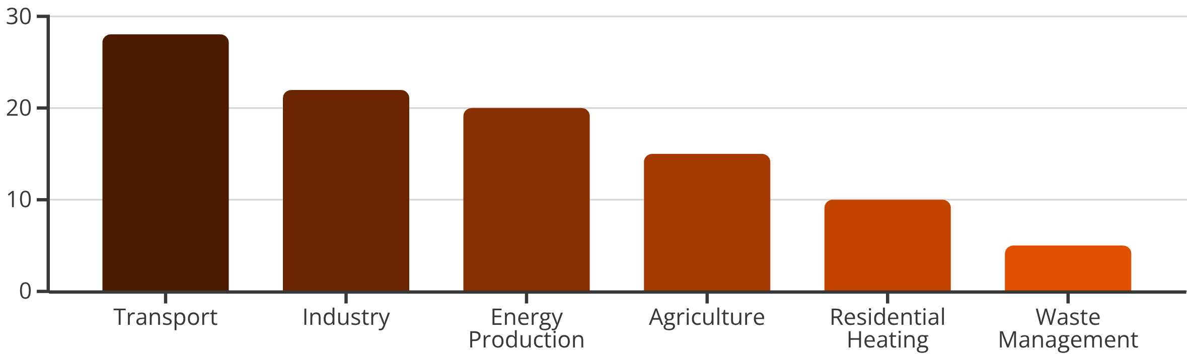
Major Contributors to Air Pollution
Transportation Sector
Industrial Processes
Energy Generation
The largest single contributor globally. Diesel vehicles, aviation, and shipping emit vast quantities of nitrogen oxides and particulate matter. Urban areas bear the heaviest burden.
Manufacturing, chemical production, and mining operations release diverse pollutants. Heavy industries in developing nations often lack stringent emission controls.
Coal-fired power plants remain significant polluters despite renewable energy growth. Fossil fuel combustion releases sulphur dioxide, mercury, and greenhouse gases.

Slide 11

Health & Environmental Impacts of Poor Air Quality
Respiratory Diseases
Cardiovascular Problems
Neurological Effects
Chronic exposure causes asthma, bronchitis, and reduced lung function. Particulate matter penetrates deep into lung tissue, triggering inflammation and reducing oxygen absorption capacity.
Air pollution increases risk of heart attacks, strokes, and hypertension. Fine particles enter the bloodstream, causing systemic inflammation and arterial damage.
Recent research links air pollution to cognitive decline, dementia, and developmental delays in children. Ultrafine particles can cross the blood-brain barrier.
7M
$5T
90%
Premature Deaths Annually
Global Economic Impact
Population Affected
WHO estimates air pollution causes 7 million premature deaths worldwide each year, making it one of the leading environmental health risks.
Healthcare costs and lost productivity from air pollution-related illnesses exceed $5 trillion annually, affecting both developed and developing economies.
Over 90% of the world's population breathes air exceeding WHO guideline limits, with urban populations in developing nations most vulnerable.
Environmental Consequences: Beyond human health, air pollution damages ecosystems through acid rain, reduces agricultural yields, accelerates climate change, and degrades visibility and aesthetic quality of natural landscapes.

Slide 12





Solutions to Reduce Air Pollution
Addressing air pollution requires coordinated action across policy, technology, and individual behaviour. Successful strategies combine regulatory frameworks with innovative solutions and public engagement.
Sustainable Transportation
Transitioning to electric vehicles, expanding public transport networks, promoting cycling infrastructure, and implementing congestion pricing in urban centres.
Clean Energy Transition
Replacing fossil fuel power generation with renewable sources, improving energy efficiency in buildings, and investing in battery storage technology.
Industrial Innovation
Implementing best available technologies, carbon capture systems, stringent emission standards, and circular economy principles in manufacturing.
Green Infrastructure
Creating urban forests, green corridors, and vegetation barriers that naturally filter pollutants whilst providing ecosystem services and improving livability.
Policy & Regulation
Enforcing strict emission standards, establishing low emission zones, providing incentives for clean technology adoption, and international cooperation on transboundary pollution.

Slide 13
Impact Of Project On Earth, Humanity & World
🌱 1. Impact on the Earth (Environmental Impact) :
🌤️ Helps Reduce Air Pollution
By predicting future AQI and pollutant levels, the system helps authorities and citizens take preventive actions such as:
Reducing vehicle usage on high-pollution days
Implementing temporary industrial controls
Planning green initiatives in hotspots
🌿 Supports Environmental Conservation
Reliable pollution forecasts help organizations:
Monitor environmental health
Identify pollution sources
Track the effectiveness of policies like “green zones,” afforestation, or emission limits

Slide 14
👥 2. Impact on Humanity (Public Health & Safety) :
❤️ Protects Human Health Air pollution leads to:
Asthma
Respiratory infections
Heart problems
Early deaths
Your forecasting system helps people:
Use masks or air purifiers on high-pollution days
Avoid outdoor activities when AQI is unhealthy
Make informed decisions for children's, elderly, and patients’ safety
🛡️ Early Warnings Save Lives Predictive alerts allow:
Hospitals to prepare
Citizens to take precautions
Governments to issue advisories
This makes the project genuinely life-saving.

Slide 15
🌐 3. Impact on the World (Social & Global Importance)
📊 Supports Smart Cities & Global Sustainability
The project aligns with UN Sustainable Development Goals (SDG-3: Good Health, SDG-11: Sustainable Cities, SDG-13: Climate Action). It can be integrated into:
Smart city dashboards
Global pollution monitoring systems
Climate change research studies
🤝 Promotes Global Awareness :
Clear visual dashboards and forecasts help communities understand:
What causes pollution
How to reduce it
Why sustainability matters
This creates a more eco-conscious society worldwide.

Slide 16
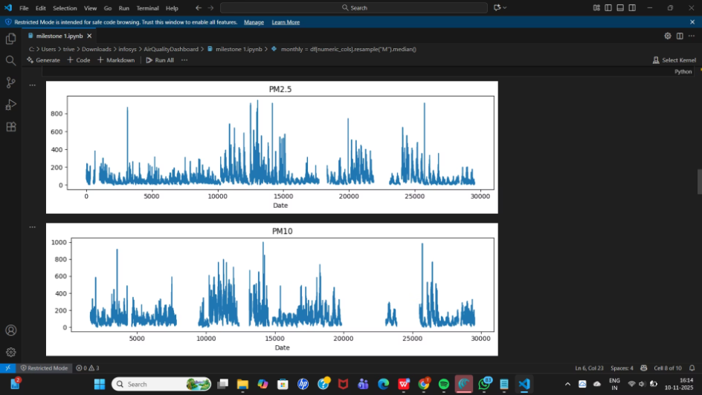
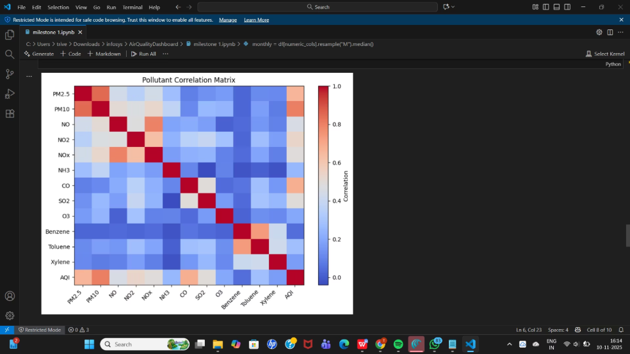
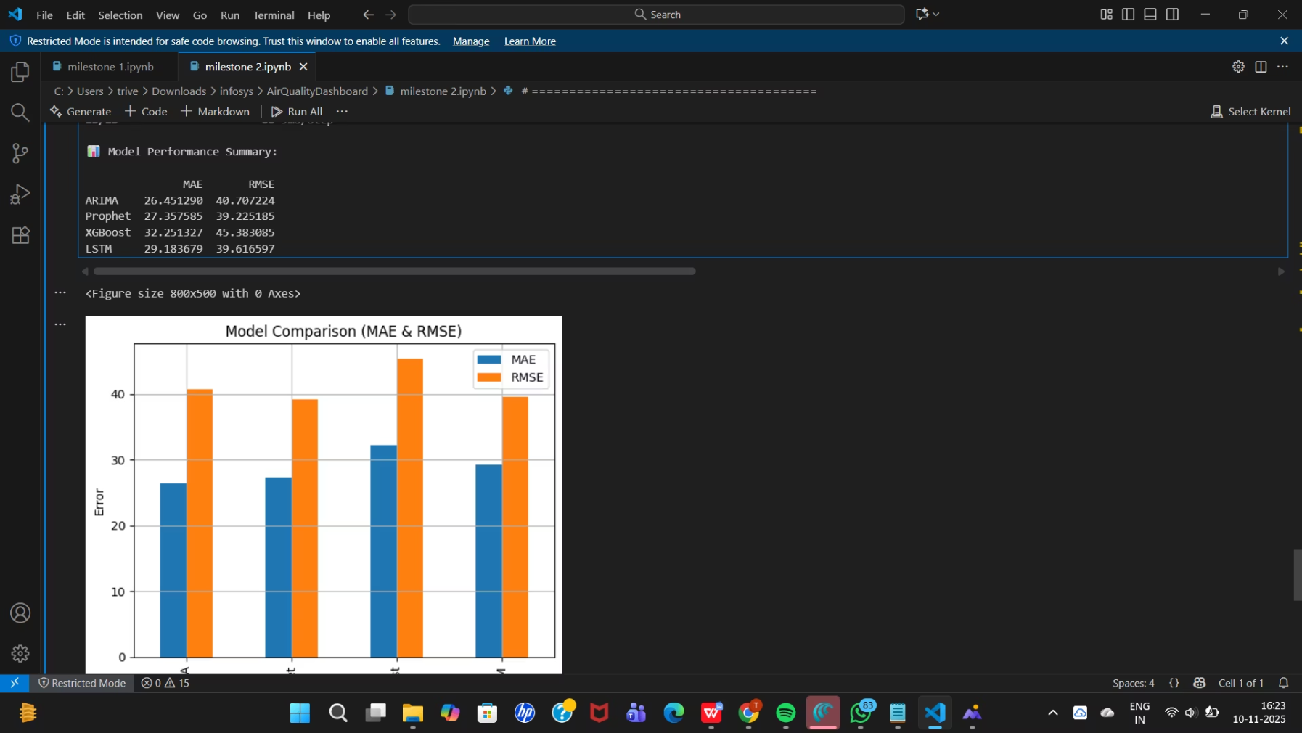

Milestone 1 & 2
Milestone 1:Data Preprocessing & EDA
Milestone 2:Model Training & Evaluation

Slide 17
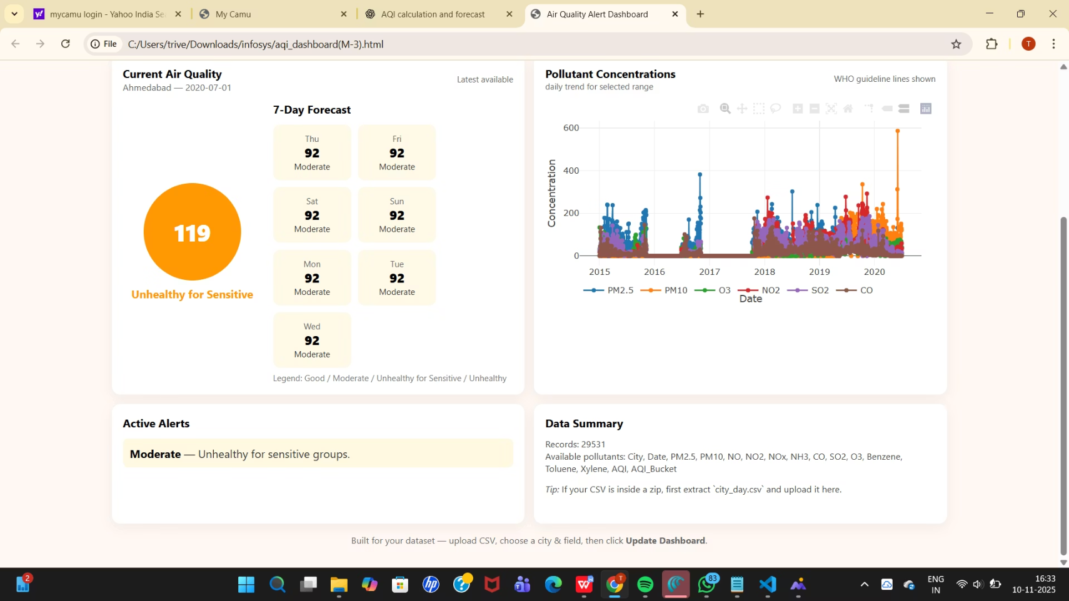

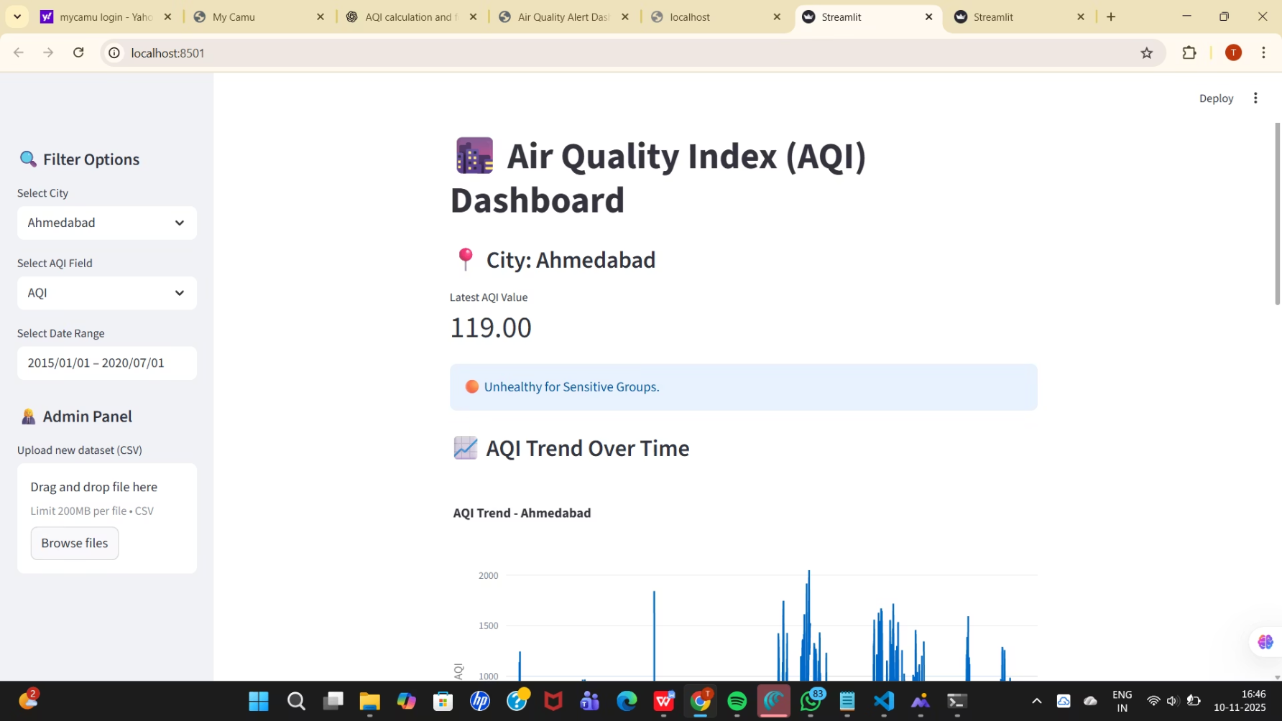
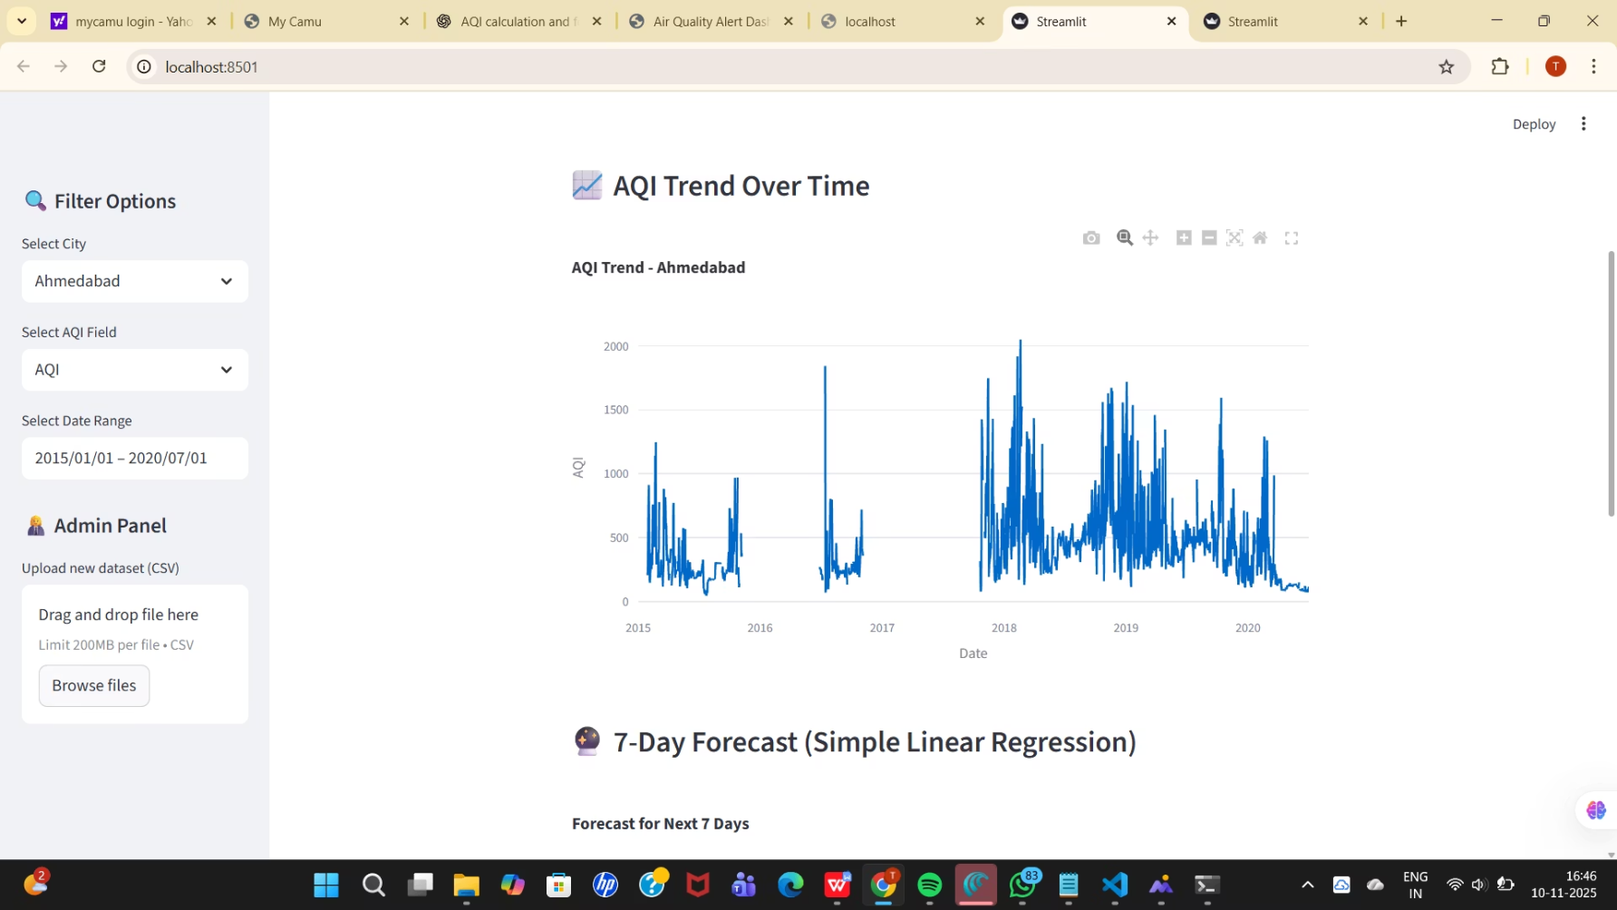
Milestone 3 & 4
Milestone 3 – Alert Logic & Trend Visualization
Milestone 4 - Streamlit Dashboard
Milestone 4 – Streamlit Dashboard

Slide 18
How the Project Works to Solve the Problem:
Data-Driven Decision Support: The system uses historical pollution data (like CO,
NO₂, SO₂, PM2.5, PM10, etc.) to identify trends and patterns that affect AQI levels.
This helps in understanding pollution behavior across time and locations.
Accurate Forecasting Using ML Models: Through ARIMA, Prophet, and LSTM
models, the system forecasts future AQI and pollutant levels. These forecasts provide
early warnings about possible air quality deterioration — enabling proactive actions
by environmental agencies.
Interactive Visualization via Streamlit: The Streamlit dashboard makes complex
data easy to interpret. Users can select pollutants, cities, or date ranges and instantly
see trends, alerts, and predictions — turning raw data into actionable insights.

Slide 19
Steps to Run the Project
1.Load Data:
Import historical AQI datasets from Kaggle.
2.Data Cleaning & Preprocessing:
Handle missing values, normalize features, and resample time series.
3.Model Training:
Train forecasting models (XG Boost, ARIMA, Prophet and LSTM)
4.Model Evaluation:
Compare accuracy using RMSE/MAE metrics.
5.Model Saving:
Store best performing model for inference.
6.Run Web App:
Execute streamlit run app.py.
Access the dashboard for predictions and alerts.

Slide 20
Future Enhancements
Roadmap for Innovation
01
02
03
Machine Learning Integration
Real-Time Data Fusion
Hyperlocal Forecasting
Implement advanced algorithms including LSTM networks, random forests, and ensemble methods for improved prediction accuracy.
Integrate satellite imagery, IoT sensors, and meteorological data streams for comprehensive environmental monitoring.
Develop street-level prediction models using high-resolution spatial analysis and mobile sensor networks.
04
05
Public API Development
Health Impact Assessment
Create accessible interfaces allowing developers to build applications leveraging our forecasting models.
Link AQI predictions with epidemiological models to forecast health outcomes and support preventive healthcare.

